Slide 1


Slide 2



Meet Team ErrorGPT
Md Shafkat Faruk Khan
2022 - 3 - 60 - 035
Uswat Fatemee
2023 - 2 - 60 - 077
Maysha Iqra
2023 - 1 - 60 - 152

Slide 3
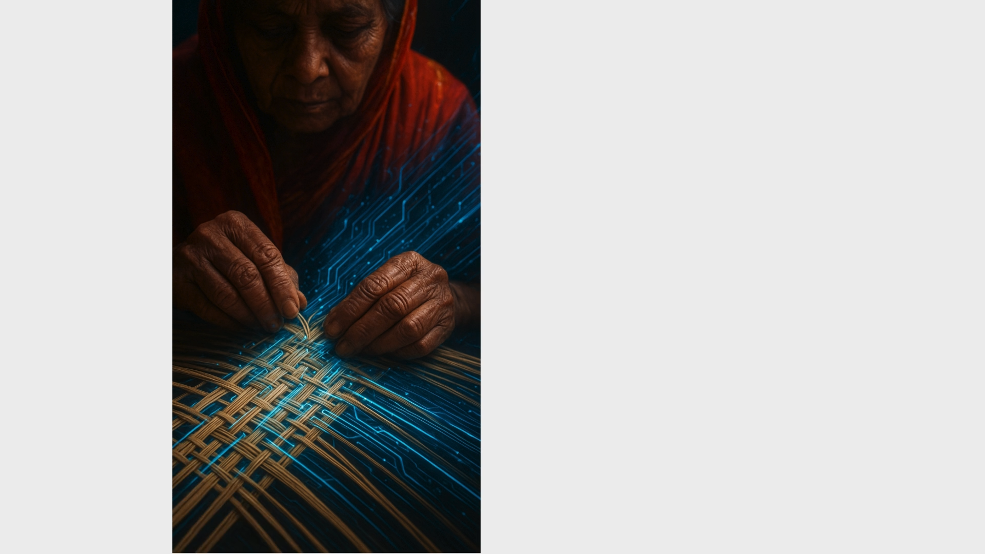

Slide 4
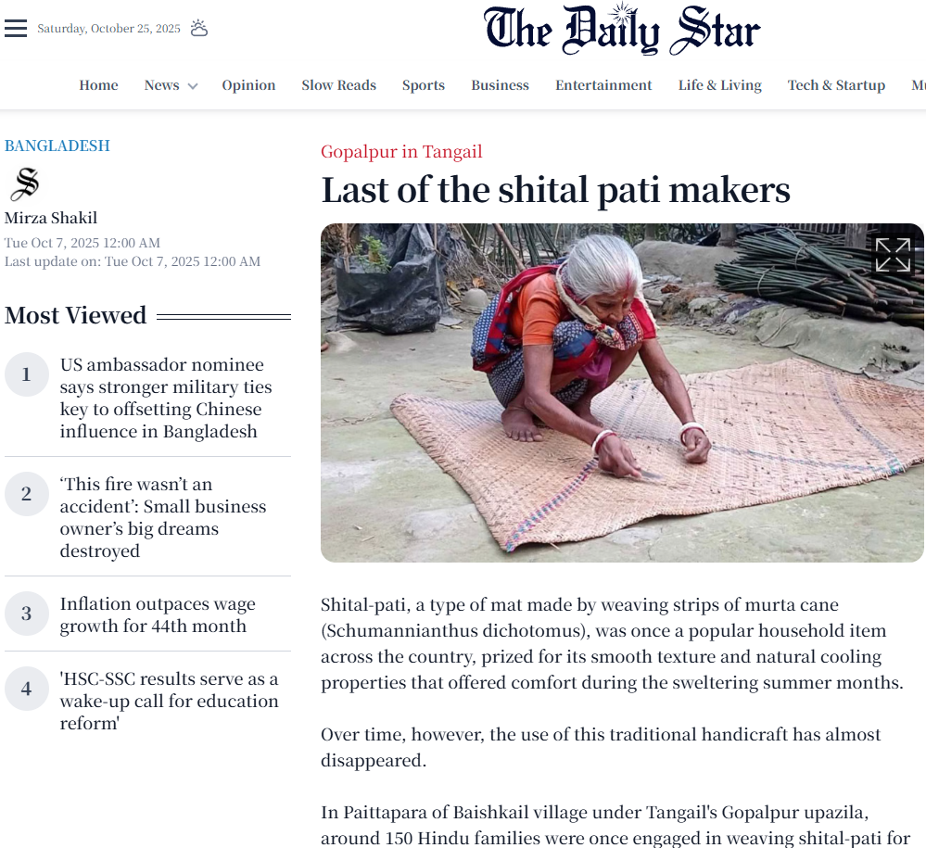
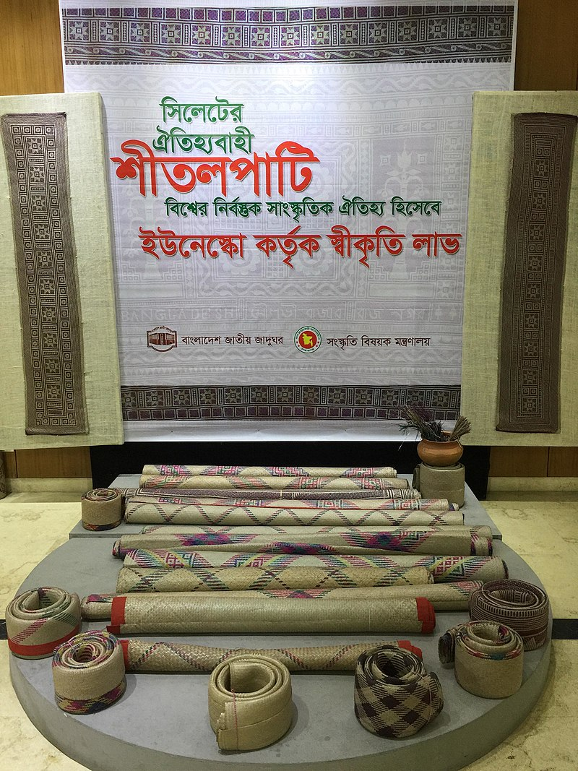

Slide 5
Motivation: Why a Heritage Marketplace?
Cultural Preservation & Identity
Safeguarding Heritage
Celebrating Authenticity
Economic Justice & Livelihood
Direct-to-Artisan Sales
Financial Stability
Digital Inclusion & Market Reach
Global Market Access
Low-Barrier Entry

Slide 6
Gaps in the System
Logistics and Fulfillment Gap
Management
The artisan sells unique, one-of-a-kind mats locally at the bazar. Due to the digital literacy gap, they cannot be expected to master a complex inventory system and thus they can’t reach the customers on a wider range beyond just the village.
Financial and Accounting Gap
Secure Transaction Logging
We know a buyer agreed to buy, but we don't have a secure, digital record of the actual payment process (e.g., payment via bKash, Nagad, or bank card). This record is separate from the sales log and is essential for financial proof.
Tax and Compliance Reporting:
The system currently does not track financial data in a way that simplifies future tax liabilities or financial reporting required for formal business operations.
UX and Literacy Gap
Simple Listing Interface
Most artisans are not digitally literate enough to navigate complex forms, manage multiple settings, or write lengthy descriptions required by existing e-commerce sites.
Language Support
Existing platforms primarily use English, which is a barrier for rural artisans who need to input data and communicate in Bangla.

Slide 7
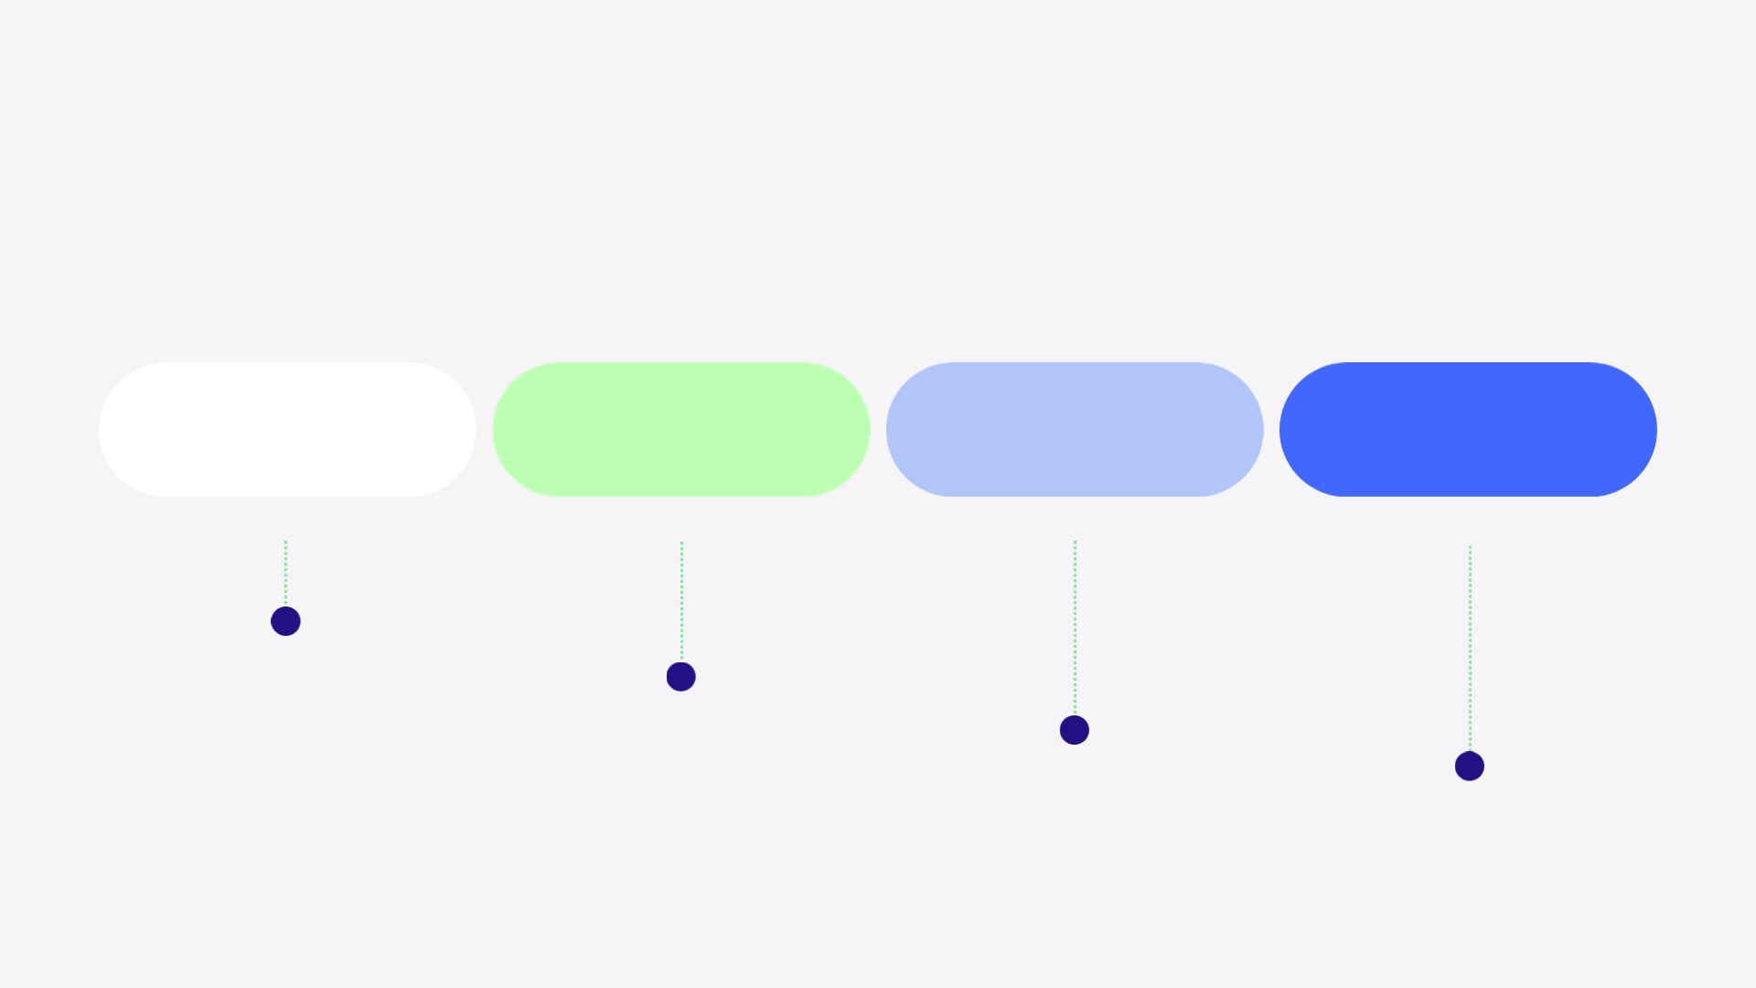

Slide 8
Economic Empowerment
To establish a direct-to-consumer sales channel that ensures artisans secure maximum profit margins, effectively ending dependence on low-paying middlemen.
To create a secure Digital Wallet and Transaction System that accurately calculates commissions and facilitates prompt, transparent payments directly to the artisan's account.
Technical Assurance
To build the system to achieve 100% success in preventing double-bookings of unique, one-of-a-kind Shital Pati mats through robust database design.
To ensure the critical online payment and confirmation process executes efficiently and reliably within a professional time limit (e.g., under 15 seconds).
Cultural Stewardship
To implement product fields that allow for the documentation and display of cultural metadata (e.g., motif type, region of origin, and artisan story), transforming a sale into a piece of documented heritage.
To develop an Icon-Driven, Bangla-First Interface for the artisan dashboard, effectively lowering the digital literacy barrier and making online sales simple and accessible.
Operational Excellence
To integrate a Delivery Management system that provides buyers with a reliable tracking ID and digital status updates, moving beyond manual, informal village delivery methods.
To provide a professional, user-friendly marketplace that successfully connects rural artisans with urban and international buyers, granting the craft global visibility.

Slide 9



1.
Saving Heritage: The core mission is to provide a digital lifeline to vanishing crafts like Shital Pati and many more, ensuring the tradition survives economic instability.
2.
Economic Justice: We guarantee fair payment and economic stability by eliminating middlemen and ensuring direct, transparent payouts to the artisan.
3.
Reliability & Trust: The platform ensures 100% data integrity to prevent double-bookings and professionalizes village fulfillment with digital tracking.
Conclusion
4.
Final Vision: Our project transforms the bazar item into a valuable global product, creating a sustainable digital future for local Bangladeshi artisans.

Slide 10
Thank You

Slide 11

Local Artisan E-Marketplace
Team ErrorGPT
Md Shafkat Faruk Khan
2022 - 3 - 60 - 035
Uswat Fatemee Maysha Iqra
2023 - 2 - 60 - 077 2023 - 1 - 60 - 152

Slide 12
Motivation
Cultural Preservation
Economic Justice
Digital Inclusion

Slide 13
Types of Stakeholders
Stakeholders
Artisans and Buyers
Regulatory/Support
External/Financial

Slide 14


Slide 15
Functional Requirements
Stakeholder | Essential Action the System Provides | Emphasis
Artisan (Seller) | Bangla-First Listing & One-Click Stock Update. | The artisan needs simplicity: the system must allow listings in Bangla and provide a simple 'Mark Sold Locally' button for stock control.
Buyer (Customer) | Cultural Search & Secure Payment. | The buyer needs trust: the system must allow searching by Cultural Motif (e.g., Nayantara) and guarantee secure payment via mobile banking
Administrator | Transaction Auditing & User Verification. | The admin needs control: the system must generate a full Transaction Audit Log and provide tools to verify new artisan accounts.

Slide 16
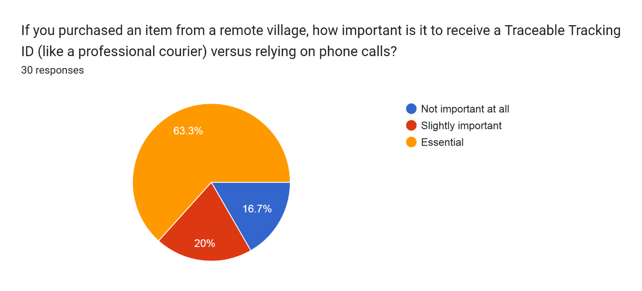
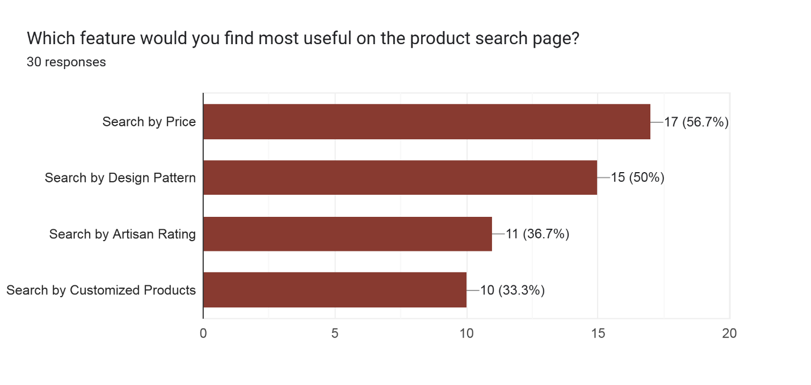
Survey Data

Slide 17
Non-Functional Requirements
Category | Requirement Highlight | Emphasis
Usability (Cultural) | Bangla-First & Icon-Driven Interface. | Our biggest constraint is Usability. The Artisan Dashboard must use minimal text and be designed for accessibility by low-literacy users.
Operational | PostgreSQL Required. | Operationally, we must use PostgreSQL because it ensures the high level of transactional integrity required to prevent system errors.
Reliability | 100% Data Integrity. | The system must achieve 100% data integrity—there can be no failures in the Inventory Locking system that lead to double-selling unique crafts.
Performance | Fast Transactions. | Finally, performance: The critical booking and confirmation process must execute reliably in under 15 seconds.

Slide 18
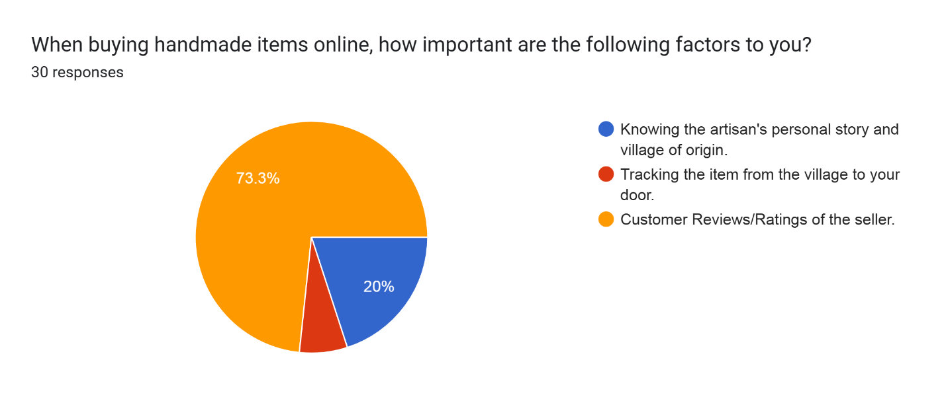
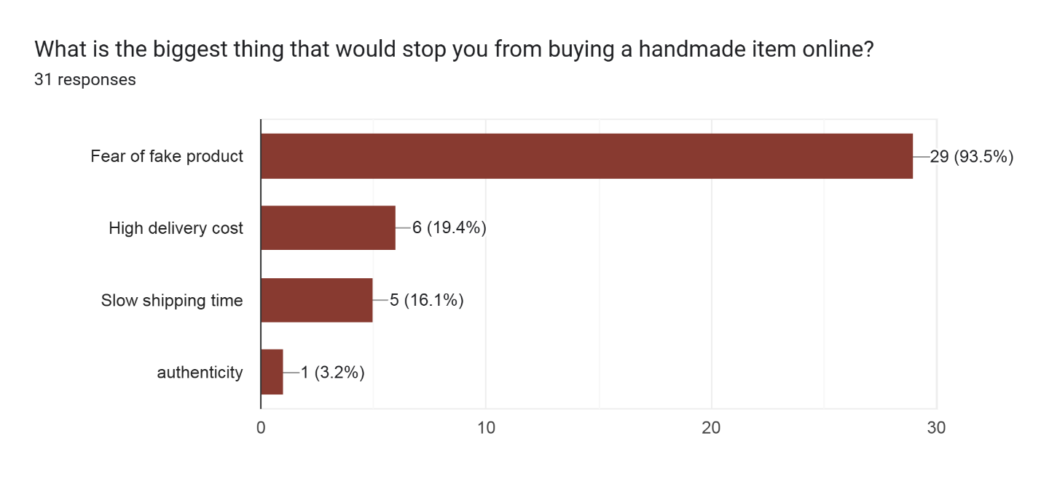
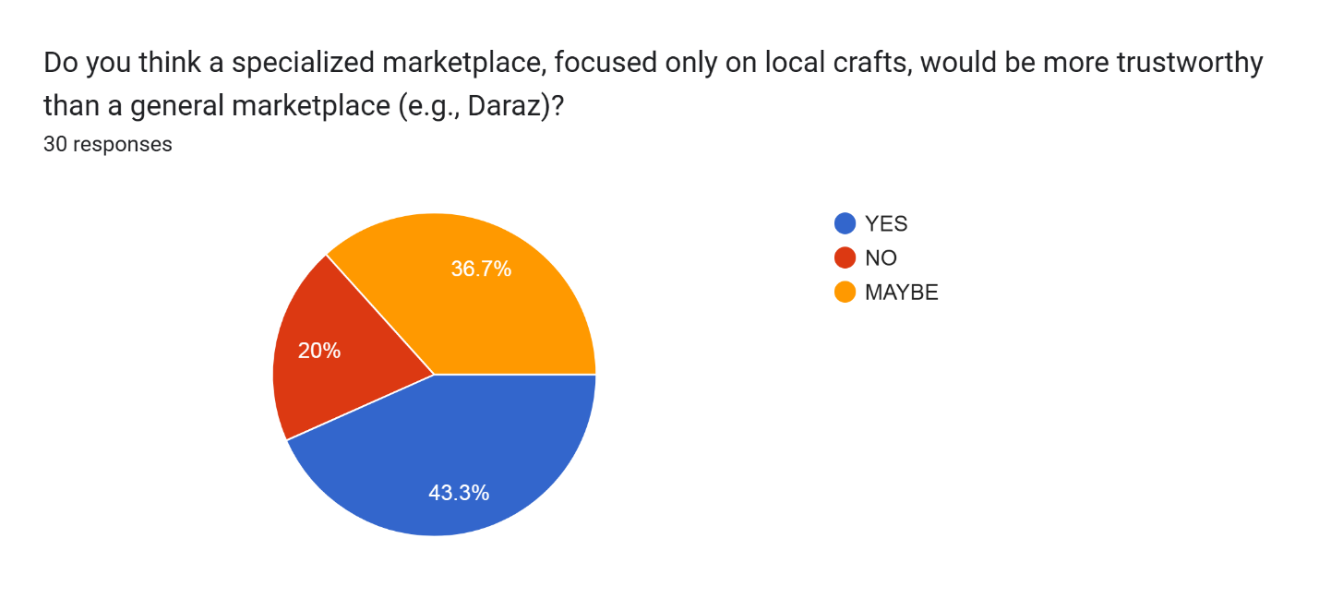
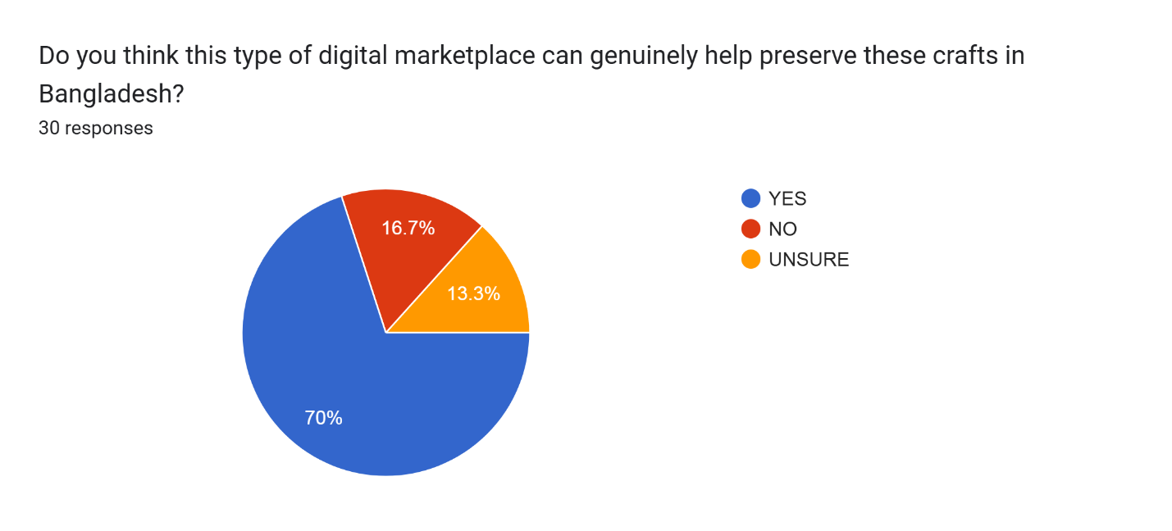
Survey Data

Slide 20


